Slide 1
The “WIRTH” Project Y-DNA and Documentary Research Collaborate to Find Ancestral Origins
HOW DNA FOUND THE GENEALOGICAL CONNECTION BETWEEN SEEMINGLY DISPARATE FAMILIES
Presented By:
RICHARD GUSSOW, ELISE FRIEDMAN
JANET AKAHA, RACHEL UNKEFER
In Memory of Herbert Huebscher
Notes:
1
1

Slide 2
Dedicated to Herb Huebscher 1926-2013

Slide 3
Agenda
Richard Gussow
Introduction & History of the WIRTH project
Elise Friedman
DNA of the WIRTH members
Janet Akaha
WEIL, TREVES & BACHARACH
Rachel Unkefer
Jewish history & migration
?
Future plans for the WIRTH project
Notes:
3
3

Slide 4
What is the WIRTH Group?
A group of >100 families with matching Y-DNA
All tested through Family Tree DNA
About 90% of members are estimated to share a common male ancestor within the past 900 years.
WIRTH is abbreviation for first 5 families in the group
Wolinsky Issroff Rossoff Tenenbaum Huebscher
Started when Herb Huebscher began a project to test other males with Huebscher surname to see if related
Other Huebschers were not a match to Herb
But he did match to someone else: Dr. Saul Issroff
Over the years, the rest of the group followed

Slide 5
A Genealogical Puzzle
The WIRTH Group has:
Different surnames
Explanation: Most Ashkenazi surnames not assigned until about 200 years ago
Different geographical origins (but nearly all in Eastern Europe)
No previously known relationships between the families
Nearly all Ashkenazi Jewish, but a few are not
Most non-Jewish WIRTHs were aware of Jewish ancestry
And one big surprise…
Notes:
5

Slide 6
The Rosa family Aguada, Puerto Rico
Santo Domingo

Slide 7
How does a Puerto Rican family fit into a group of Ashkenazi Jews?
Rosa family’s earliest known origin: births recorded in 1820-1830 in Aguada, Puerto Rico
Family came to Puerto Rico from Spain
Puerto Rican immigration records destroyed in a fire
Fact: Until the late 1800s, virtually no declared Jews in Puerto Rico
What is the Rosa connection to the other WIRTH members, who are mostly Ashkenazi Jews?
The answer may lie in Jewish history
Notes:
7

Slide 8
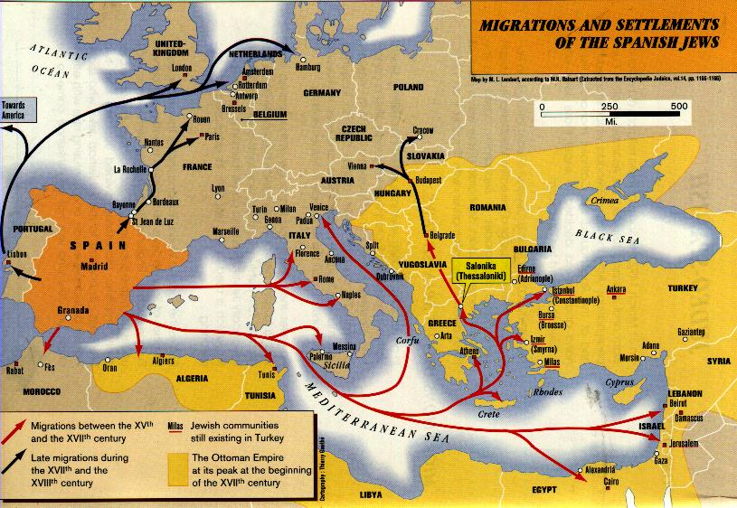
Expulsion from Spain & Portugal
Jews expelled from Spain in 1492
Jews expelled from Portugal in 1497
Where did they go?

Slide 9
Where are their descendants today?
Some never left
DNA study: About 20% of current population of Iberian peninsula are descendants of Sephardim (*)
About 20,000 Conversos in Mallorca alone (Xuetas)
Descendants in Calabria region in Southern Italy
Millions of descendants in Brazil
Several hundred Crypto Jewish families in Southwest US (particularly New Mexico)
Albukirk = Albuquerque?
Caribbean and surrounding areas were a magnet for Conversos
Cuba, Jamaica, Curacao, and
Puerto Rico
(*) Adams SM, Bosch E, Balaresque PL, et al. (December 2008). "The genetic legacy of religious diversity and intolerance: paternal lineages of Christians, Jews, and Muslims in the Iberian Peninsula". American Journal of Human Genetics

Slide 10
Do WIRTHs have Sephardic origins?
Anyone with WIRTH Y-DNA has Jewish paternal ancestry
Rosa family most likely Conversos
Some other WIRTH families have credible oral histories of Sephardic roots
Suggestive of Sephardic roots for all WIRTH members?
Or did an Ashkenazi family member make his way to Spain or Puerto Rico?
Family Finder autosomal DNA test on Pascal Rosa shows no Ashkenazi ancestry. However, this test only goes back about 5 generations (~150 years)

Slide 11
Are WIRTHs Levites?
Some WIRTH group members have a Levite family tradition
But most were not aware of a Levite tradition
Illogical to have Levites & non-Levites
Y-DNA is passed only from father to son
Levite tradition also passed only from father to son
Y-DNA and Levite tradition should go together
Therefore either all WIRTH members are Levites, or none are Levites

Slide 12
Why the Discrepancy?
Non-Levite families may have forgotten the Levite tradition
Unlike Kohanim, Levites in the Diaspora had few religious requirements and restrictions
Herb Huebscher discovered he was a Levite through a Ketuba
Some families may have “assumed” Levite status
Undocumented adoption into a Levite family

Slide 13
So are WIRTHs really Sephardic and/or Levite?
Several families with an extensive documented family history and rabbinic dynasties going back to the middle ages have been discovered to match the WIRTH group.
Some of these families lived in Spain, but are believed to be Ashkenazi rather than Sephardic.
Levite tradition questionable
Our initial assumption: Our common ancestor was a Levite and WIRTH members are Levites.
Bacharach, Treves and Weil families with extensive Rabbinical lines have no Levite tradition.
However, the Weil family has an oral history about switching of letters from the original name Levi.

Slide 14
Have we found the missing link?
Goal: To discover the identity of the WIRTH group’s most recent common ancestor (MRCA)
At the beginning of the project, the hope was that someone with an extensive documented family history would match the WIRTH group.
Have we struck gold with the WEIL, TREVIS AND BACHARACH families?
Rabbinic dynasties going back to the middle ages

Slide 15
THE DNA connection

Slide 16
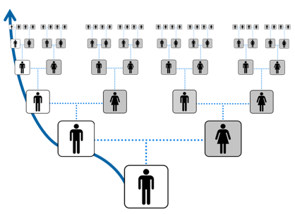
Y-DNA: The Unbroken Paternal Line
Y-DNA traces an unbroken direct paternal line (father’s father’s father’s father, etc).
Said another way, Y-DNA is passed down almost in-tact from a man to his sons, his sons’ sons, etc.
Therefore, distant cousins who trace back to a shared direct paternal line patriarch will have very similar Y-DNA results.

Slide 17
Y-DNA Markers
Y-DNA testing for genealogy looks at markers, or segments of the Y chromosome, called STRs – Short Tandem Repeats.
STRs comprised of repeating DNA sequences. Example:
AGATAGATAGATAGAT… AGATAGATAGATAGAT
1 2 3 4 … 9 10 11 12
DYS393 = 12
Notes:
17

Slide 18
Y-DNA Markers
Each STR marker tested by the lab to count the number of repeats. Counts/values recorded and reported to customer.
STR marker values are compared between two people to determine whether they match or not.
An exact or very close match at a sufficient number of markers typically indicates a genealogical relationship – within hundreds of years rather than thousands of years.
Family Tree DNA offers 12, 25, 37, 67 and 111 markers.
37 markers or higher is best for genealogical purposes.
Number of repeats can changes over time – these are random mutations that happen between father & son, but not every generation. These mutations can represent branching points of an extended family tree.
Notes:
18

Slide 19
Herb’s 25-Marker Y-DNA Results
NO. | 1 | 2 | 3 | 4 | 5 | 6 | 7 | 8 | 9 | 10 | 11 | 12
Marker Name | DYS 393 | DYS 390 | DYS 19 | DYS 391 | DYS 385a | DYS385b | DYS 426 | DYS 388 | DYS 439 | DYS 389-1 | DYS 392 | DYS 389-2
HERB | 12 | 23 | 14 | 10 | 14 | 15 | 11 | 15 | 12 | 14 | 11 | 31
NO. | 13 | 14 | 15 | 16 | 17 | 18 | 19 | 20 | 21 | 22 | 23 | 24 | 25 | - | -
Marker Name | DYS 458 | DYS 459a | DYS 459b | DYS 455 | DYS 454 | DYS 447 | DYS 437 | DYS 448 | DYS 449 | DYS 464a | DYS 464b | DYS 464c | DYS 464d | DYS 464e | DYS464f
HERB | 15 | 9 | 9 | 11 | 11 | 25 | 15 | 20 | 29 | 13 | 13.1 | 15 | 16 | 16 | 16
Two anomalies:
Marker 23 – value 13.1 rather than just 13.
Two extra 16 values after marker 25.
Notes:
19

Slide 20
Saul’s 25-Marker Y-DNA Results
NO. | 1 | 2 | 3 | 4 | 5 | 6 | 7 | 8 | 9 | 10 | 11 | 12
Marker Name | DYS 393 | DYS 390 | DYS 19 | DYS 391 | DYS 385a | DYS385b | DYS 426 | DYS 388 | DYS 439 | DYS 389-1 | DYS 392 | DYS 389-2
SAUL | 12 | 23 | 14 | 10 | 14 | 15 | 11 | 15 | 12 | 14 | 11 | 31
NO. | 13 | 14 | 15 | 16 | 17 | 18 | 19 | 20 | 21 | 22 | 23 | 24 | 25 | - | -
Marker Name | DYS 458 | DYS 459a | DYS 459b | DYS 455 | DYS 454 | DYS 447 | DYS 437 | DYS 448 | DYS 449 | DYS 464a | DYS 464b | DYS 464c | DYS 464d | DYS 464e | DYS464f
SAUL | 15 | 9 | 9 | 11 | 11 | 25 | 15 | 20 | 29 | 13 | 13.1 | 15 | 16 | 16 | 16
Same anomalies!
All WIRTH members have these anomalies.
Notes:
20

Slide 21
Who Is A WIRTH?
He exhibits the two WIRTH anomalies at markers 22-25+ (DYS 464a-f)
His Y-DNA STR values closely match other WIRTH males.
Notes:
21

Slide 22
Y-DNA of First 30 WIRTH Families at 67 Markers

Slide 23
Closely Matching DNA of WIRTH Members
All numbers with white background represent matches with each other.
All numbers with yellow background are mutations off the “modal” values, which we believe to be the ancestral DNA values of the WIRTH patriarch.
Shared yellow background numbers suggest common branching off the ancestral DNA.
Two of the 30 people match the modal exactly (white background at all markers)

Slide 24
SNP: Another Mutation
SNP = Single Nucleotide Polymorphism
SNPs are another type of DNA mutation, and they define a person’s haplogroup and subclade (subgroup/branch) on the human family tree.
Through 2011, all WIRTHs were found to be in subclade J2a4b1, defined by the SNP named M92.
In 2011, a WIRTH member was tested under FTDNA’s “Walk Through the Y” advanced testing program, intended to identify new SNPs that had never been discovered before. Two new SNPs were discovered:
L556
L560
Notes:
24
24

Slide 25
New SNPs Unique to WIRTH Group
Validity of new SNPs L556 & L560 confirmed:
We tested 30 WIRTH members, including those furthest from the modal. ALL 30 tested positive for both new SNPs.
We tested four non-WIRTH persons whose STR marker results are closest to WIRTHs. All four tested negative for both new SNPs.
Conclusion: All WIRTHs have these two new SNPs, and they are unique to the WIRTH group.
WIRTH group received its own subclade below M92, defined by the two new SNPs – name TBA
Notes:
25
25

Slide 26
Update: Who Is A WIRTH?
He exhibits the two WIRTH anomalies at markers 22-25+ (DYS 464a-f)
His Y-DNA STR values closely match other WIRTH males.
He tests positive for the two new SNPs: L556 & L560
Notes:
26

Slide 27
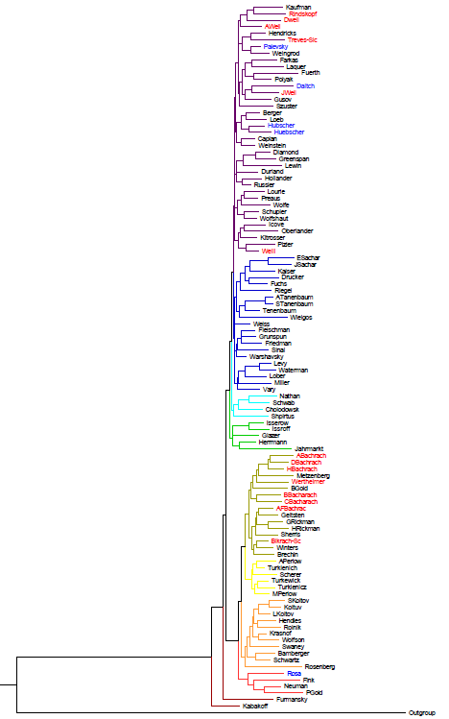
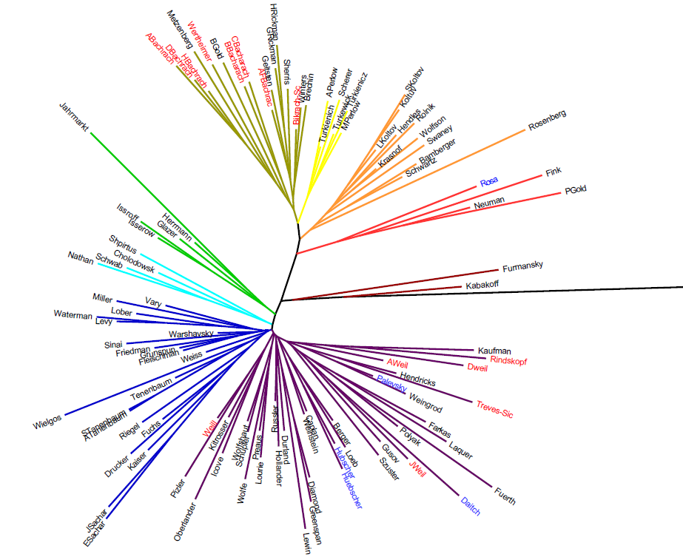
Phylogenetic Trees
Rectangular Tree Layout
Radial Tree Layout
Tools:
McGee Y-Utility
SplitsTree4
FigTree
111-Marker haplotypes
From 107 WIRTH members

Slide 31
The paper trail

Slide 32
Two Complementary Approaches
WIRTH Project: Starts with present (DNA) and moves backward until paper trail dead-ends (1700s)
Frankfurt Project: Starts with past (Frankfurt Paper Trail from 14th century) and moves forward to find living descendants for DNA testing
Bacharach Project: Combines these two approaches

Slide 33
Frankfurt
Many families had stable surnames as early as the 14th or 15th centuries. A few examples:
Bach(a)rach (WIRTH) | Rindskopf (WIRTH)
Fulda | Rothschild
Goldschmidt | Speyer
Guggenheim/er | Treves (WIRTH)
Heilbrun | Weil (WIRTH)
Luria | Wertheim (WIRTH)
Oppenheim/er

Slide 34
DNA Matches Bridging to Paper Trail
Documented Ancestor
b. 1300
Generation 1
b. ca 1330
Generation 14
b. 1670
Gen 15 A
b. 1700
Gen 15 A
b. 1700
Gen 15 B
b. 1702
Gen 15 B
b. 1702
Dead End
Dead End
Dead End
Gen 16 A
b. 1730
GGF b. 1880
Gen 16 A
b. 1730
Gen 16 B
b. 1732
Gen 16 B
b. 1732
GF b. 1880
GF b. 1910
Father b.1910
Father, b. 1940
Gen 24 A
b. 1970
Gen 24 A
b. 1970
Gen 24 B
b. 1972
Gen 24 B
b. 1972
Living b. 1950
Living b. 1970
DNA Match:
Estimated 8 generations to A
&10 generations to B
DNA Match:
Estimated 10 Generations
to both

Slide 35
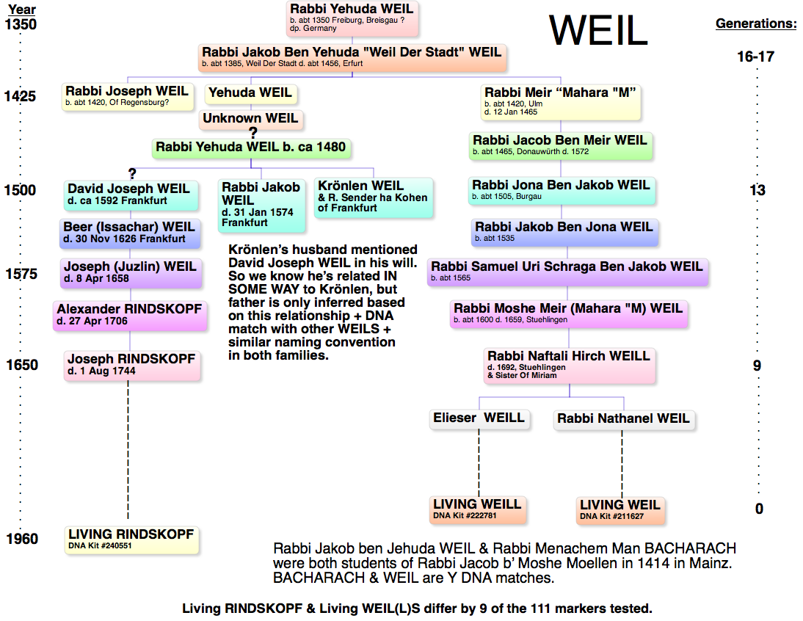

Slide 36
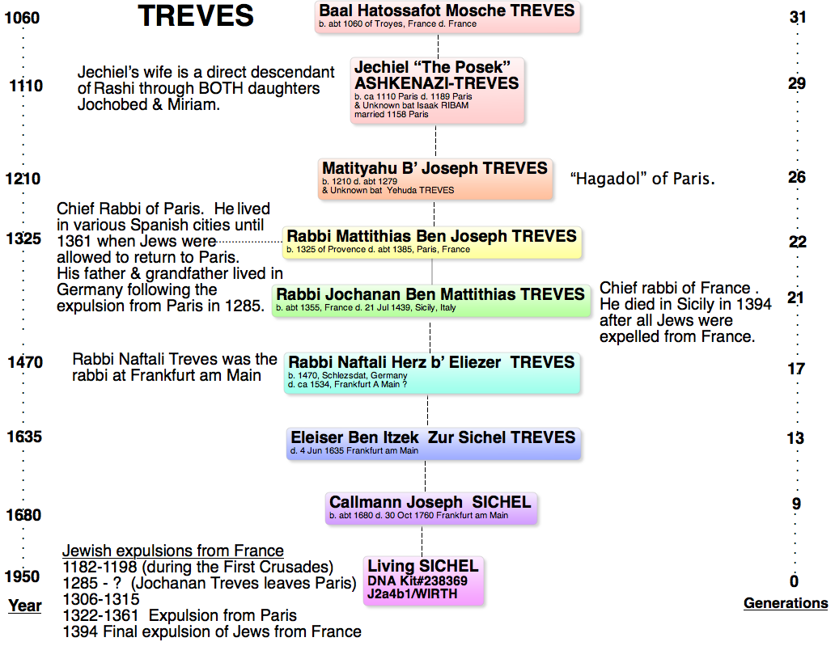

Slide 38
Challenging Assumptions About Jewish Genealogy
Assumption: You should search for people with your family surname only in the specific village where you know they lived at one time.
Fact: Many Jewish families were highly mobile, particularly if they were merchants or rabbis. They were often forced to move in order to marry and set up households. Mass expulsions occurred frequently. From generation to generation, their location could change.
Several Eastern European WIRTH Project participants have a recent common ancestor with German participants within 8 generations. Herb Huebscher noticed the matches with BACHARACH and contacted us about including our participants in the WIRTH project.

Slide 39
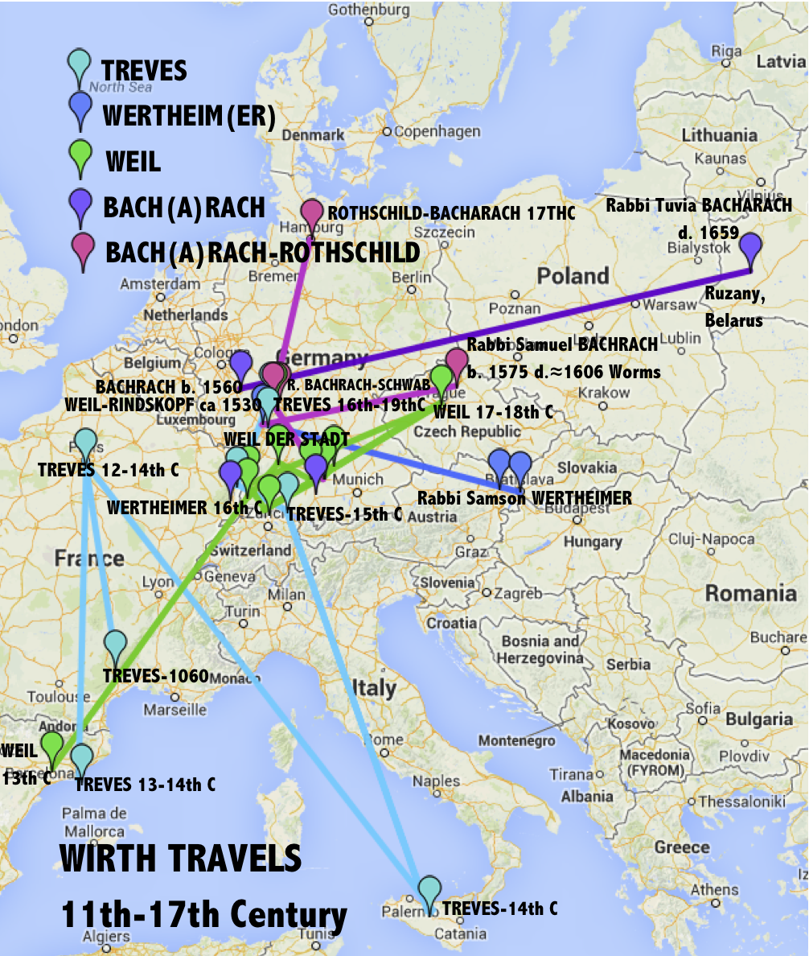

Slide 41
Challenging Assumptions About Jewish Genealogy
Assumption: People with the same surname from different geographic areas are not related to each other.
Fact: Some surnames persisted over centuries and across geographic boundaries. Bach(a)rachs who lived in: Belarus (1600s), Lithuania/Poland (1700s), Southern Bavaria (1600s), France (1700s), and Hesse-Darmstadt (1700s) share a common genetic ancestor.

Slide 42
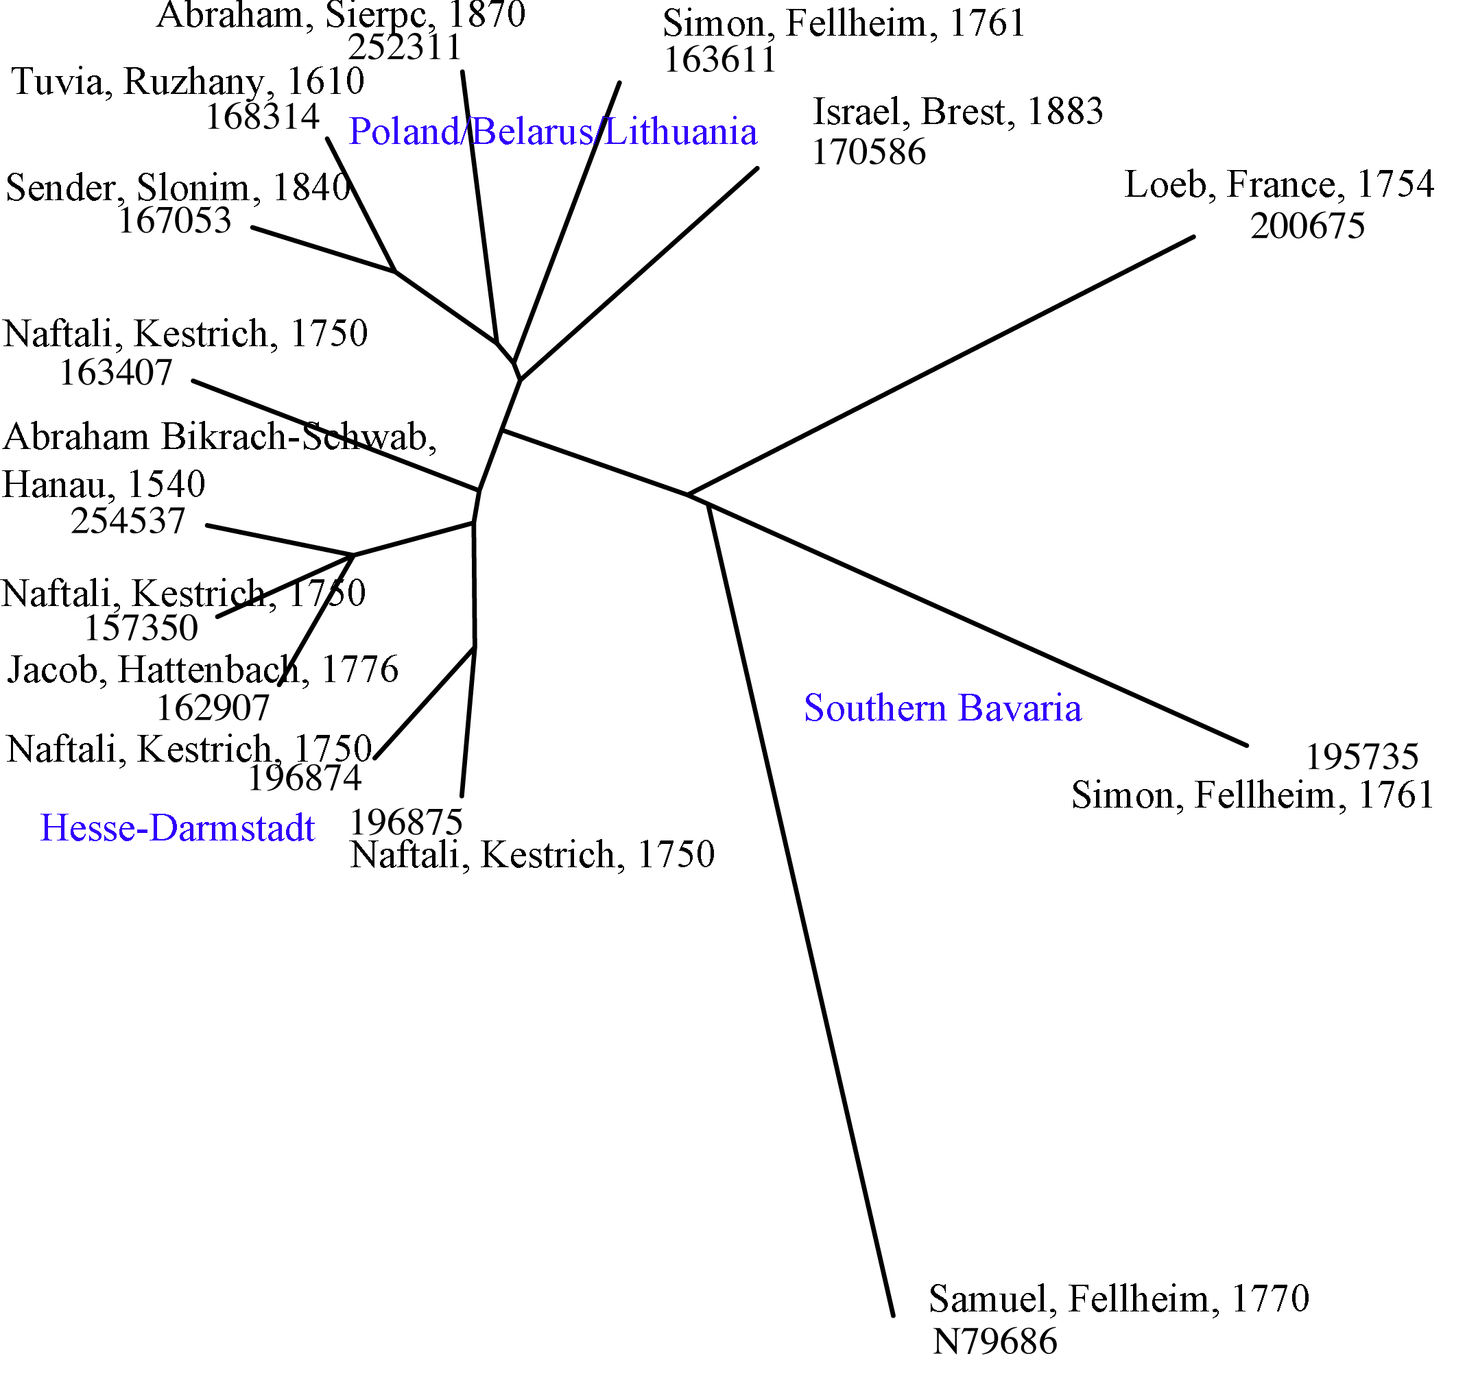
Estimated Relationships
Among Bacharach Project
Participants who have the surname. Geography Not
Necessarily a Predictor of
Genetic Relationships, although there are clusters.

Slide 43
Conclusion
We may never be able to document all the intervening generations, but a DNA match to a documented descendant of an early tree will create a “bridge” to a deeper pedigree.
The Frankfurt and Bacharach projects link all the WIRTH project participants to these older documented families.

Slide 44
What’s next?

Slide 45
What’s Next?
Herb’s dream will live on!
Richard Gussow now leading the WIRTH project with Judy Simon & Saul Issroff as co-admins. Elise Friedman, Rachel Unkefer and Janet Akaha will continue working closely with the project.
Continue inviting new matches to existing WIRTH members to join the project.
Further DNA testing of existing and prospective WIRTH members.
Continue refining TMRCA estimate as new WIRTH members are discovered.

Slide 46
What’s Next?
Recruit more DNA testers from well-documented families such as WEIL, TREVES, BACHARACH, WERTHEIMER, SICHEL, RINDSKOPF & ROTHSCHILD.
If you have a male relative or even a friend with these names, please ask them to participate!
Please send us your family trees with these names.
www.BacharachDNA.com
www.JewsofFrankfurt.com

Slide 47
Herbert Huebscher WIRTH Research Project Memorial Fund
We have created a fund in Herb’s memory to help support the continuation of the WIRTH project. Funds will be used for:
DNA testing of select individuals
Further document research
If you are interested in contributing to the fund, you may do so by U.S. check made out to:
"Herbert Huebscher WIRTH Research Project”
In Boston:
Provide to Richard, Saul, Elise, Rachel or Janet
At Home:
Email Judy Simon for her postal address: heyjude0701@gmail.com

